Slide 1

LINUX SERVICES
STEPHEN JAMES, PHIL FOX
UBNETDEF, SYSTEMS SECURITY
FALL 2020
Fair Use Act Disclaimer: This presentation is for educational purposes only. All included materials are properly limited in purpose, nature, amount and effect.

Slide 2
AN OVERVIEW:
This is a useful lecture to attend and pay close attention to!
Today we are introducing some concepts about services
We’re also walking through an assignment very similar to this week’s homework together.
Take context-focused notes tonight
A command list is provided for the in-class exercise
Commands in a batch list aren’t really helpful without context
Record what services and tools do, how they work, and why they’re desirable over others
You’ll use many different but similar commands on your homework
Notes:
Client: GUI Option
Ubuntu Web: [nano, vi, vim] /etc/netplan/01-netcfg.yaml
--$ sudo netplan apply
CentOS: [nano, vi, vim] /etc/sysconfig/network-scripts/ifcfg-[interface name e.g. ens192]
--$ systemctl restart NetworkManager

Slide 3

UP-FRONT GLOSSARY
Servers:
Software that provides services or functionality that can be used by other programs, or
Dedicated hardware providing network-facilitated services for remote clients
Clients:
Software that accesses services or functionality provided by servers, or
Endpoint (hardware) devices that self-serve applications and receive network-facilitated services from servers
Host (v.): To provide a service
Host (n.): A non-network endpoint device (i.e. clients and servers)
Local: Within the same piece of hardware
Remote: Separated by at least one (non-local) network connection

Slide 4

UP-FRONT GLOSSARY
Servers:
Software that provides services or functionality that can be used by other programs, or
Dedicated hardware providing network-facilitated services for remote clients
Clients:
Software that accesses services or functionality provided by servers, or
Endpoint (hardware) devices that self-serve applications and receive network-facilitated services from servers
Host (v.): To provide a service
Host (n.): A non-network endpoint device (i.e. clients and servers)
Repercussion: Hosts host to hosts. Gross.
Local: Within the same piece of hardware
Remote: Separated by at least one (non-local) network connection

Slide 5
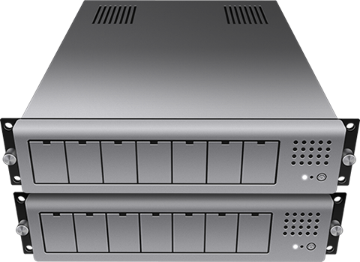

WHO HAS THE SERVICES?
Number of users
In GENERAL:
A client: Runs scores of services for a strictly limited amount of users
A server: Runs fewer services but some for 100-1M users (hardware-dependent)
Services are persistent
Number of services

Slide 6
NARROWING THE SERVICE SPECTRUM
IT usage for the term services can be ambiguous
Technically, your laptop's wireless network manager is a "service."
What we're after are server-served services. Which ones can you name?

Slide 7
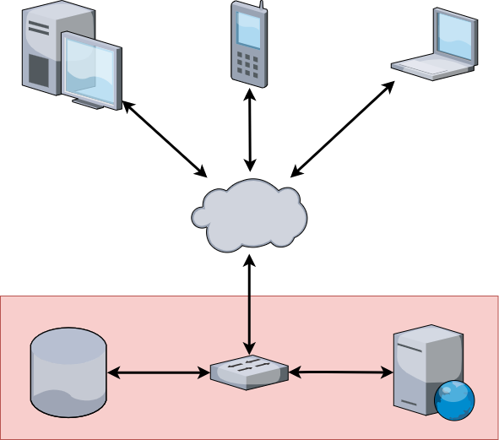
NARROWING THE SERVICE SPECTRUM
IT usage for the term services can be ambiguous
Technically, your laptop's wireless network manager is a "service."
What we're after are server-served services, namely:
Website provisioning: Express.js today, Apache this week
Database storage and retrieval: PostgreSQL today, MariaDB (MySQL) this week

Slide 8
PROTOCOLS
Top level: An agreed on way to communicate
What kind of protocols can you name? (Let’s consider real-life examples first)

Slide 9

PROTOCOLS
Top level: An agreed on way to communicate
What kind of protocols can you name? (Let’s consider real-life examples first)
...enter a prediction that somebody used a USPS analogy (good work)

Slide 10
PROTOCOLS
Top level: An agreed on way to communicate
What kind of protocols can you name? (Let’s consider real-life examples first)
...enter a prediction that somebody used a USPS analogy (good work)
Network/Physical level: Mediums of transmission and addressing
Application Level: Provide a way to package, access, and sometimes store transmitted data
Machines agree on data types and ports for information transfer

Slide 11
PROTOCOL EXAMPLE: DATABASES
No "standard" ports, Database Management Systems (DBMSs) have distinct communication protocols
They also usually have their own clients to interact with them
Popular examples:
PostgreSQL: 5432/tcp
MariaDB/MySQL: 3306/tcp
Microsoft SQL Server (MSSQL): 1433/tcp
MongoDB: 27017/tcp
Redis: 6379/tcp

Slide 12
WHAT DOES A DATABASE DO?
Yes, they manage data...
Namely in formats and hierarchies such as schemas, tables, columns, rows, etc.
Efficient storage and retrieval
Why not just use an OS filesystem?
Database software is engineered differently
Even when using the same language
Connected platforms decide on how to balance file system versus database storage
You’ll be hands-on with two very distinct examples this week

Slide 13
IN-CLASS EXERCISE init
Ground rules:
Student cameras on, SecDev cameras off please
Group checkpoint feedback will be facilitated by Zoom reactions (test)
We won’t leave anybody behind
Feel inclined to use the handout to work ahead; ask questions in chat and/or find a breakout if you get stuck
We aren’t going to tell you when to use sudo; it’s important to establish habits for minimal use
Using the vi/vim text editor isn’t mandatory
If you have a preferred editor feel free to install/use as desired
Use ifconfig to find your two device IP addresses and write them down somewhere for quick access

Slide 14
IMPLEMENTATION 1: DATABASE SETUP
Big picture: Your web service needs a database to handle its data.
The web server needs to spend its resources on serving pages and handling connections. Give it a break!
A server isn’t a database server without the right software
Good news: Many free solutions
Databases are not quite web-service ready out-of-the-box
They were originally built for manual data entry
At best, they’re configured for same-device (I.e., localhost) usage
So, we’ll install software and get our database configured for web server support!

Slide 15
OTHER SERVICE PROTOCOLS:
Email: Not just acronym salad
SMTP & IMAP: Asymmetric services for senders and client retrieval from server respectively
POP3: Replaces IMAP but stores only local copies client-side
DNS!
Remote access: RDP (Windows!), SSH
File transfer: FTP, FTPS, SFTP, SCP
Web: HTTP, HTTPS (starting to sound familiar?)
…and many more!

Slide 16
SERVICES TO FOCUS ON: SSH
This is a remote access protocol that provides an encrypted client-server connection
Computer Science assignments sometimes require this protocol for turning assignments in!
This is the protocol that you used for your Overthewire connection in HW4
Offers secure communication
Typically used to access a shell (via the command line) or to remotely execute a command
Among other things, it can also be used to copy files (e.g., SCP, SFTP)
Standard port: 22/tcp
OpenSSH is, by far, the most common (and free) SSH server

Slide 17
SERVICES TO FOCUS ON: WEB
Web servers process incoming requests from clients for web resources over HTTP and related protocols
Web resources are identified by a Uniform Resource Locator (URL)
Might perform additional processing while handling the request
HTTP is unencrypted; data is transmitted in plaintext
Anyone on any of the networks on a path from you to the server can see this data
VPNs can obscure this otherwise ‘eavesdroppable’ data
HTTPS is an extension of HTTP that is encrypted using TLS, or previously, SSL
Client is also able to authenticate the server (using the server’s certificate often ‘signed’ by an authority)

Slide 18
SERVICES IN CONCERT: HOW WE GET TO HTTPS://UBNETDEF.ORG/
Get an IP address, gateway, etc.
Either via DHCP or static IP configuration (facilitated via a network service)
Resolve "ubnetdef.org" to an IP address
Ask a DNS server for the A (if using IPv4) or AAAA (if using IPv6) records for "ubnetdef.org"
DNS server should respond with "128.205.44.157"
Send an HTTP GET request to 128.205.44.157 on port 443 asking for host ubnetdef.org and path "/"
TCP handshake starts, and public keys etc. are exchanged (since we're using HTTPS)
Web server processes request then responds
Note that the above steps are simplified: Even more happens!

Slide 19
IMPLEMENTATION 2: WEB SERVER SETUP
Big picture: We need to set up a frontend experience for our web clients
“Our cat costume consultation LLC needs a slick website”
The server needs appropriate software to become a web server
Most web platform software defaults to a same-device database
We’ll re-configure it for correct...
...connection details (Which layer on the TCP/IP model? OSI?)...
...and database protocol (Which layer on the TCP/IP model? OSI?)

Slide 20
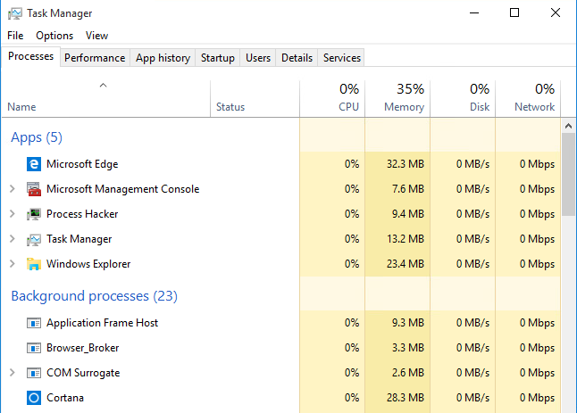
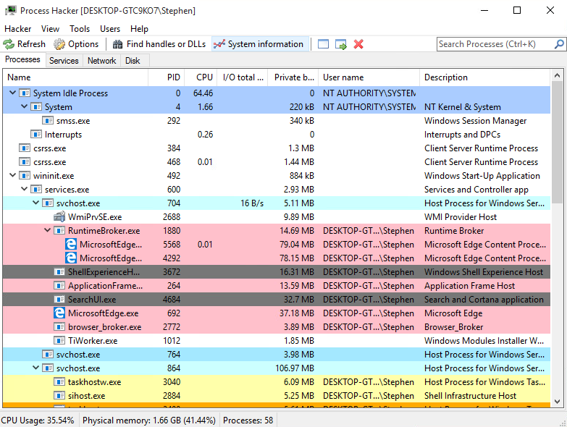
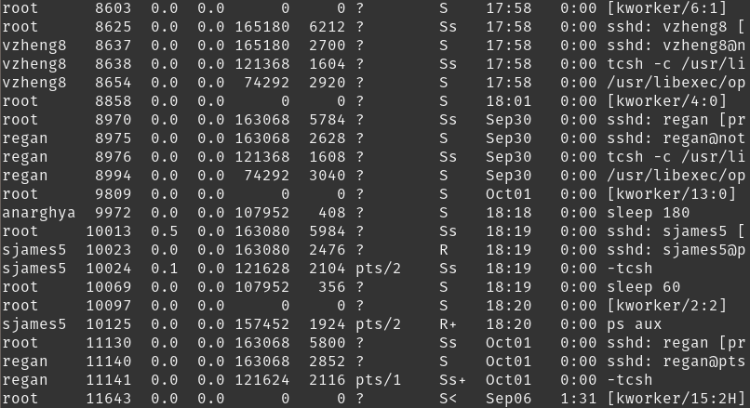
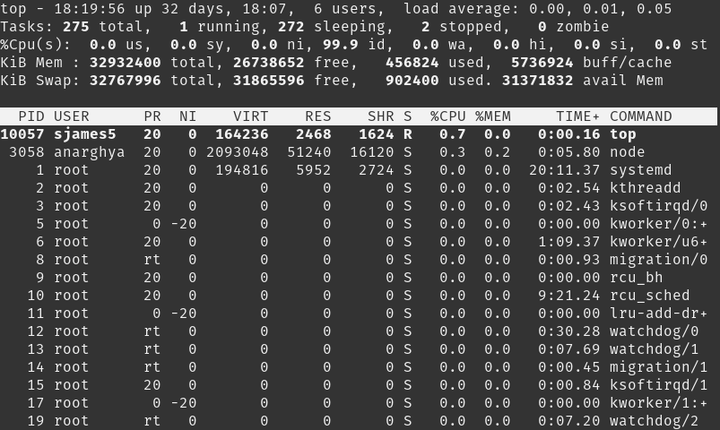
HOW CAN I SEE MY MACHINE’S SERVICES?
System monitors and task managers:
Task Manager
Windows Built-in
Process Hacker
Windows Freeware
$ ps
Linux Built-in
$ top
Linux Built-in

Slide 21
FINDING HARDER-TO-SEE SERVICES
Scan your network/hosts
Red and Blue team tactic
Network/host scans can expose ports that are open/closed/filtered
Open ports show which services might be running
Tools like nmap can often provide details about which specific services (including versions) are installed

Slide 22
DEEPEST SERVICES DIVE
Further means exist to show exactly what services are running when!
Configuration files
Databases, remote access, web, file transfer
May require further evidence that configurations are active
Logs
File system journals, security logs, system logs, etc.
Often challenging to parse in a human-readable way

Slide 23
YOUR HOMEWORK
Uses the same “hardware” and operating systems
Expects a different database engine (MariaDB) and web software (MediaWiki)
Has installation steps that are well documented by the software developers
We also provide a document with high-level guidance
Ends with you installing an open-source wiki-clone
Maybe you could use one of these for a future project!

Slide 24
WHAT QUESTIONS DO YOU HAVE?
DISCLAIMER: We may or may not be available to help on Mattermost next Friday evening
This is in the top 3 most difficult assignments
Pseudo-mastery this week will benefit at least one important future assignment
Plan wisely
Use office hours

Slide 25



GO FORTH; ROCK
@XPHILFOX
@STEPHENORJAMES

Slide 26

NETWORK TECHNOLOGY
Automation
Algorithm
Problem Solving

